Slide 1
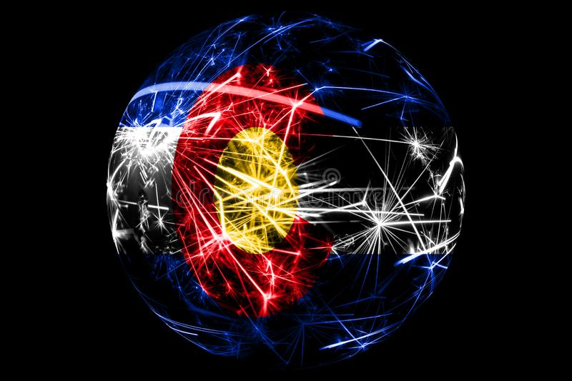
Introduction – John Williams CDOT-DMO ITS Technology Manager
9 Years – Helicopter Tech
Network Administrator
4 Years – Electronic and VLSI Lab Tech
IT Business Administration
20 Years – ITS-IT Technology Manager

Slide 2
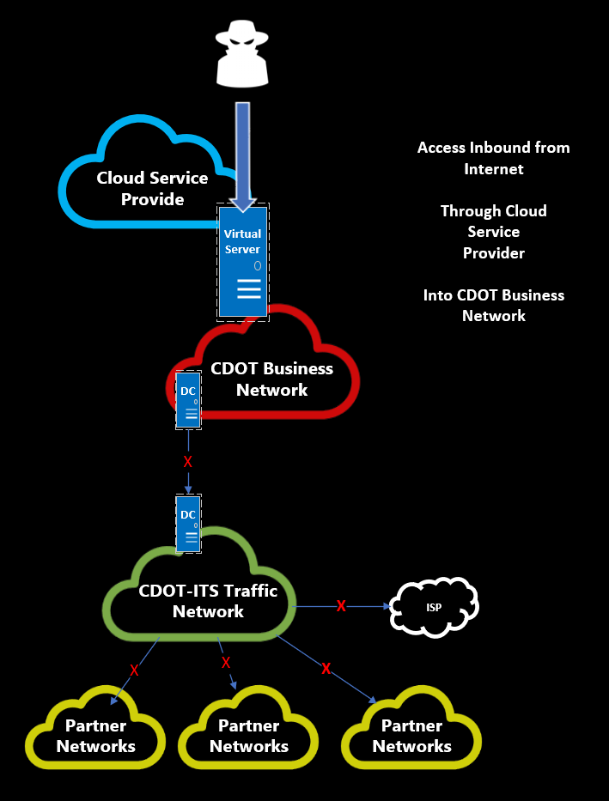
February 2018 Cyber Incident
What happened and How
Feb 18
OIT Virtual
Server Created
Feb 20
OIT Virtual
server
compromised
Feb 24
OIT
Partners
Onsite and
Work with
OIT
Mar 1
New
attacks
and activity
Additional
resources
requested
Mar 9
CO
National
Guard
Other
Partners
depart
Mar 5
Unified
Command
Group
and EOC
established
Mar 23
80%
Restoration
Operational
functionality
Feb 21
SamSam
Attack
Launched
ITS Partner
Networks
Interfaces
Turned
Down
Mar 2
CO
National
Guard
onsite
Mar 6
Containment
declared,
restoration
of services
underway
Mar 10-22
OIT works with CDOT
To recover systems
ITS experiences
disruptions as
systems restored
Feb 28
OIT
Believes
Containment
in place
Containment and Eradication
Recovery of Services
2 Weeks
2 Weeks

Slide 3
CDOT-ITS Affected Systems
System | CDOT ITS-Network | CDOT Business Network | Status | Comment
Traffic Operations & Management | On network |  | Operational
R1, R3, R4 Traffic Signals | On network |  | Operational
R2 Traffic Signals | On network | On network | 50% Operational | In transition to ITS network
R5 Traffic Signals |  | On network | Operational | Linux based Application
R1 Ramp-metering |  | On Network | Non-operational
EJMT Tunnel Control | On network Traffic Mgmt. | On network - tunnel control | Tunnel Mgmt. Non-operational Traffic Mgmt. operational
HLT Tunnel Control | On network ITS DR Site | On network - tunnel control | Tunnel Mgmt. Non-operational ITS DR Site operational
Tolling | On network |  | Operational
Video Management | On network |  | Operational
Public Traveler Information | On Network |  | Operational | CoTrip.org
ITS Devices | On network |  | Operational | VMS, CCTV, Radar, etc

Slide 4
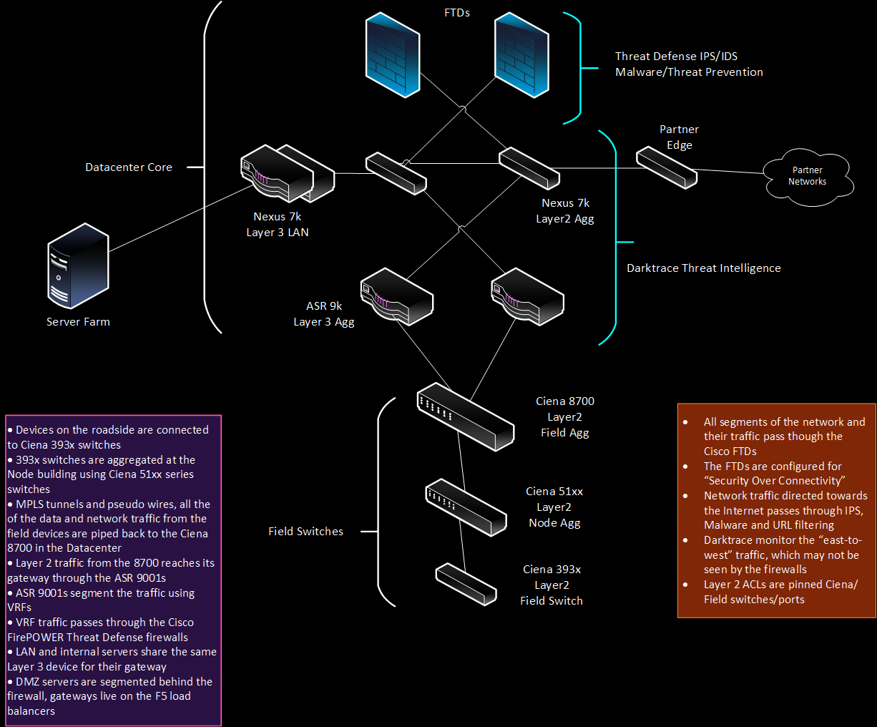
How did CDOT-ITS Prepare
Good network design through segmentation
Force North & South network traffic through Threat Defense (CISCO Firepower)
Intrusion Detection Systems (IDS)
Intrusion Prevention Systems (IPS)
Threat Intelligence
Pattern & Train Network AI
User & End-Point Activity

Slide 5
Lessons Learned
Leadership, Managers and Supervisors’ Program of Work must include Security
Equipment, Tools and Contractors do not show up prior to a Cyber Incident for free
Treat all partner networks as foreign Networks
No such thing as a trusted network
Segment or Suffer
Segment network traffic by business need, function and roles
Thread Defense is more that a firewall
Enforce Packet Inspection for all segmented network traffic
Enforce IPS/IDS
Supplement Security with Threat Intelligence for East & West network traffic
Pattern user and network activity
Train Network AI for automated responses
Implement early security monitoring and alerting tools
End Point Virus software will not always save the day
Patch endpoints frequently during Maintenance Windows
Enforce Identity and Access Mgmt. Cyber Security Policies
2 Factor authentication is not hard

